Slide 1


Poverty, globalisation, and Latin American politics
Alan Freeman
Afreeman@iwgvt.org
www.iwgvt.org

Slide 2
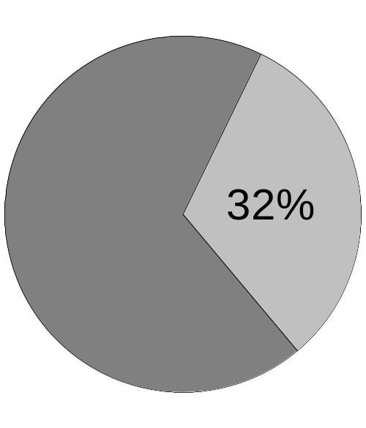
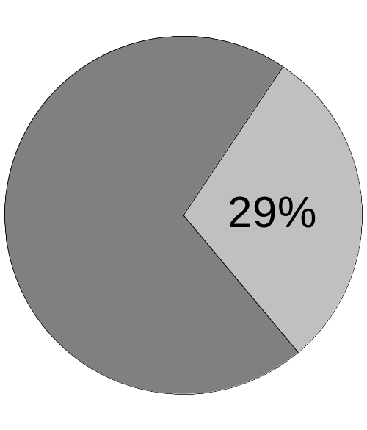
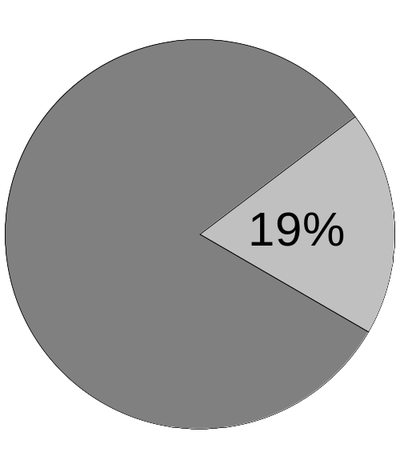
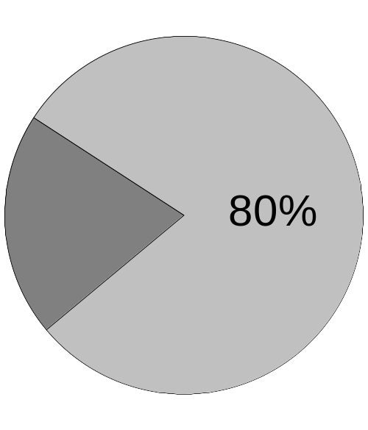
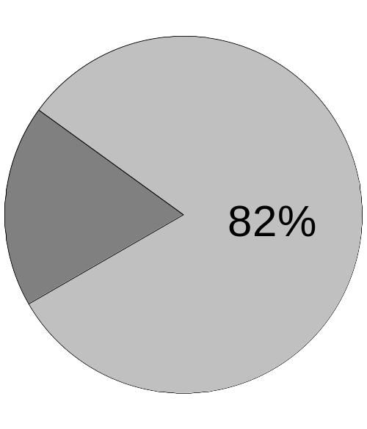
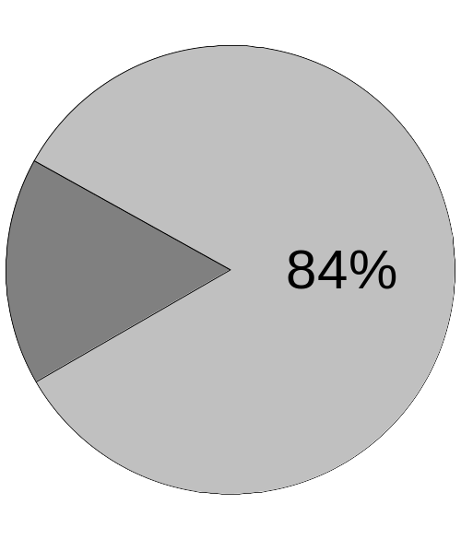
Inequality under globalisation
1970
1980
2000
Income
People
Income per head
Advanced | $10,473 | $18,088 | $26,201
Rest | $1,248 | $1,690 | $1,160
Ratio | 8.4 | 10.7 | 22.6

Slide 3
What has happened under globalisation?
In 1980, the income of the advanced countries was 11 times larger, in proportion to their population, than the rest of the world.
By 2000 this ratio had hence risen to 23.

Slide 4
How many rich people can there be?
How many people in the South can equal the income of the North?
Total income of South = $6,148 bn (avge $3/day)
Average income of North = $25,672
6,148,000,000 ÷ 25,672 = 231,380,000
= 20 per cent of the South
Everyone else would get nothing at all

Slide 5
Is privilege sustainable?
1970-80
1980-90
1990-2000
North America
24.6
24.8
20.9
SE Asia
128.9
68.1
19.9
Euro Area
122.0
25.4
-8.4
Rest
35.4
-19.8
-14.5
Growth of GDP per capita

Slide 6
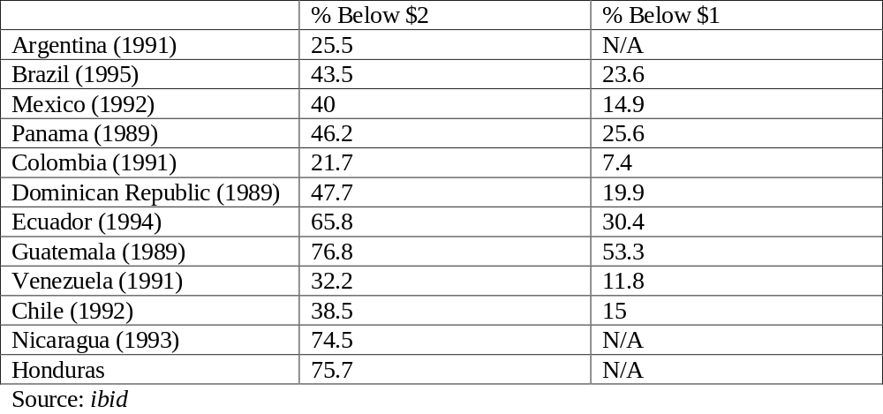
Grasping the extent of poverty (1)

Slide 7
People in Latin America living under:
$1 per day: 9,470,000,000
$3 per day: 37,620,000
£5 per hour: 90,000,000
  Venezuela 1981: 90% average $241
  Venezuela 2001: 97% average $147
http://iresearch.worldbank.org/PovcalNet/jsp/index.jsp

Slide 8
Progress of the minimum wage

Slide 9
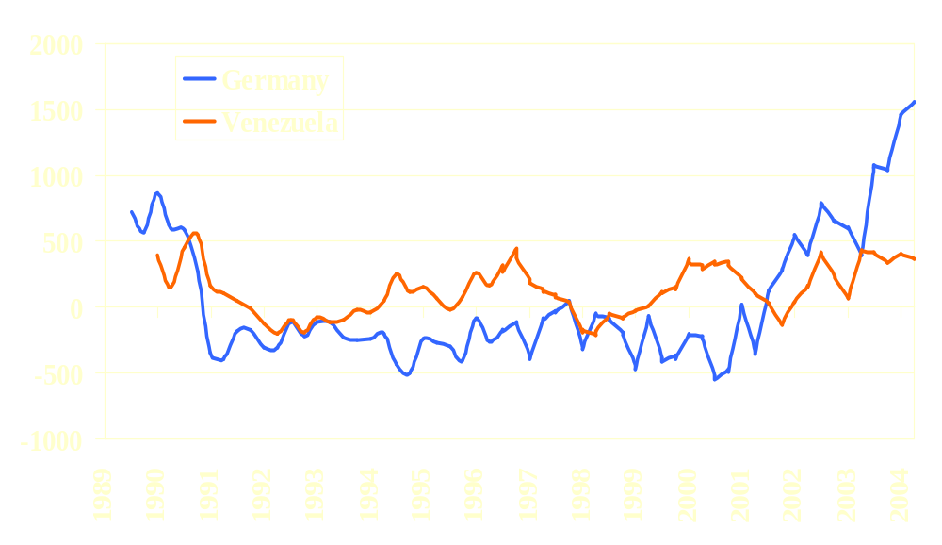
Social choice or economic necessity?
Trade surplus in dollars per head per quarter

Slide 10
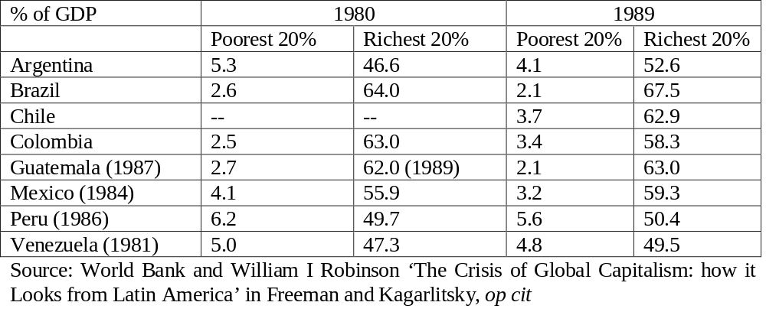
Divergence in Latin America

Slide 11
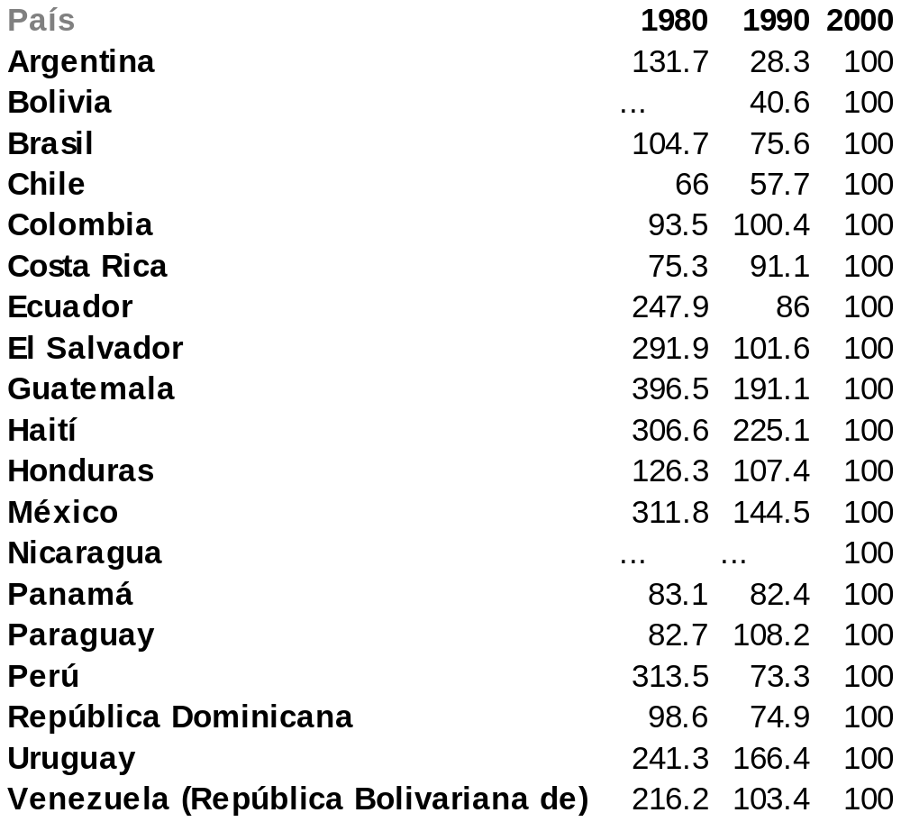
The minimum wage in Latin America

Slide 12
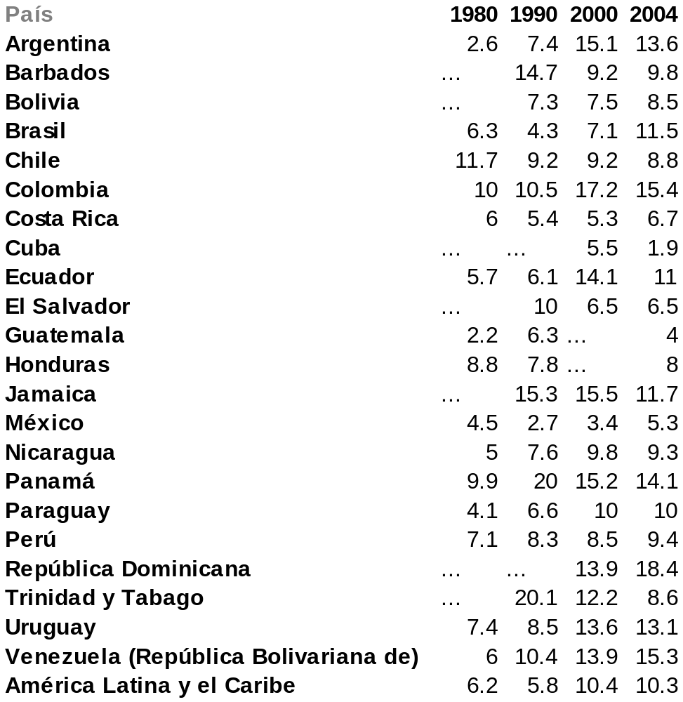
Number of unemployed (millions)

Slide 13
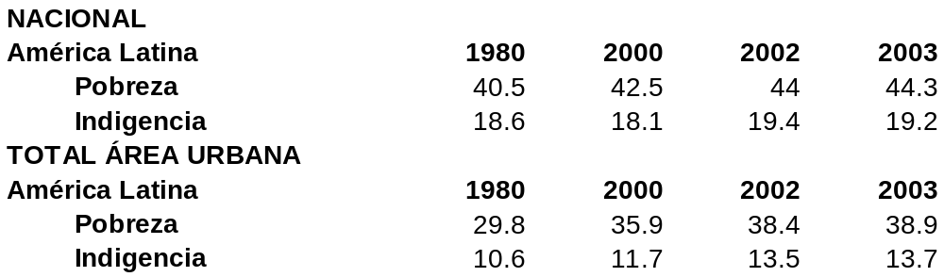
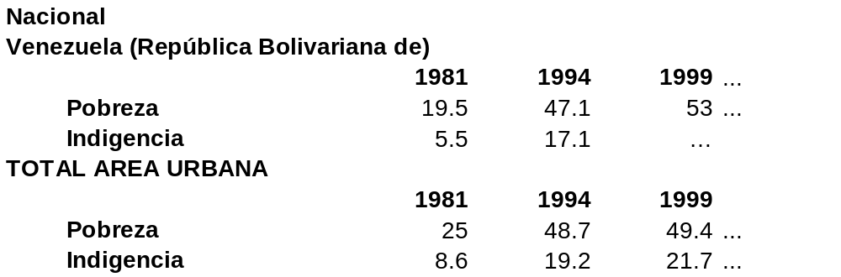
Percentage of poor

